Slide 1
Representing a 3D Environment Advanced Game Design & Development
Danny Jugan

Slide 2
3D Environments
There are two parts of the Transform component that we need to look at.
Position (Vector3)
Points in space (x, y, z)
Rotation (Quaternions / Euler Angles)
Euler Angles are representations of rotations on the three axes (x, y, z)
Don’t mess with Quaternions unless you know what you’re doing

Slide 3
Moving objects
Let’s move some objects around in Unity using various Vector3 positions and Euler rotations
Creating Vectors and Eulers in code
Moving objects over time

Slide 4
Lerp and slerp
Lerp – Linearly interpolates between two vectors
Slerp – Spherically interpolates between two vectors.
static Vector3 Lerp(Vector3 from, Vector3 to, float t);
Interpolates between from and to by the fraction t.

Slide 5
Lerp and slerp
Lerp – Linearly interpolates between two vectors

Slide 6
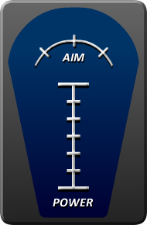
Exercise
How would you get the yellow arrow to move back and forth along the aim arc at the top?

